Slide 1
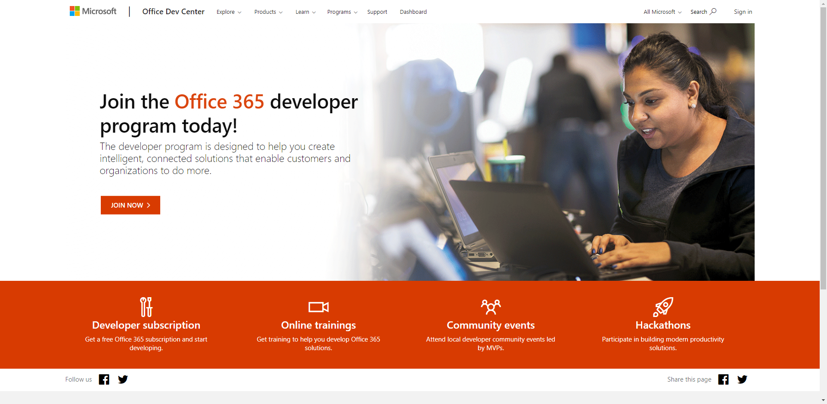
Sign up for an Office 365 Developer Tenant
Sign up for the Office Developer Program - https://aka.ms/offdp
You will receive welcome mail with link to sign up for Office 365 tenant
Notes:
A developer tenant is no different than a normal production tenant. Microsoft provides developers, through the Office Developer Program to get access to a developer tenant. The developer tenant same thing you would normally get when you purchase Office 365 licenses.
> [!TIP]
> Sign up for the Office Developer Program at [https://aka.ms/offdp](https://aka.ms/offdp).

Slide 2
AN INTRODUCTION TO DEVELOPMENT WITH THE SHAREPOINT FRAMEWORK (SPFX)
Introducing the SharePoint Framework

Slide 3





AN INTRODUCTION TO DEVELOPMENT WITH THE SHAREPOINT FRAMEWORK (SPFX)
Don Kirkham
Solutions Architect
Microsoft Certifications
Professional Developer
Azure
Power Platform
Microsoft 365
Contact Info
https://DonKirkham.com
donkirkham@live.com
@DonKirkham
@DonKirkham

Slide 4



What’s with the airplanes?

Slide 5

Introducing the SharePoint Framework (SPFx)
What is the SharePoint Framework and how did we get here?
Configuring your Office 365 tenant for SPFx development
Configuring your local SPFx development environment
Build your first SPFx Hello World webpart
Deploying your solution
Notes:
In this unit, you'll learn what the SharePoint Framework is and how to configure your developer environment.

Slide 6


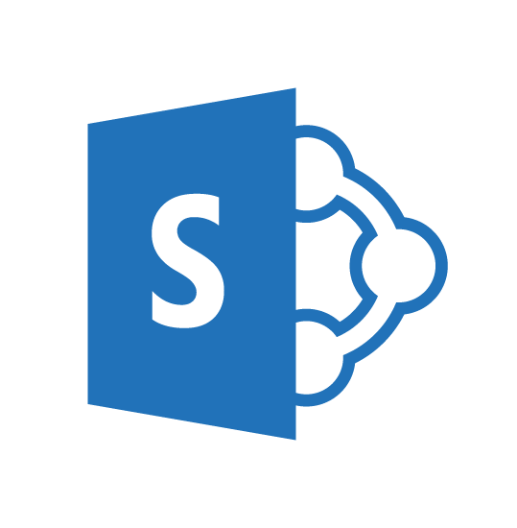
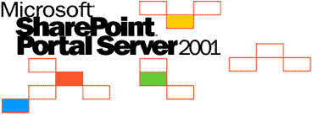
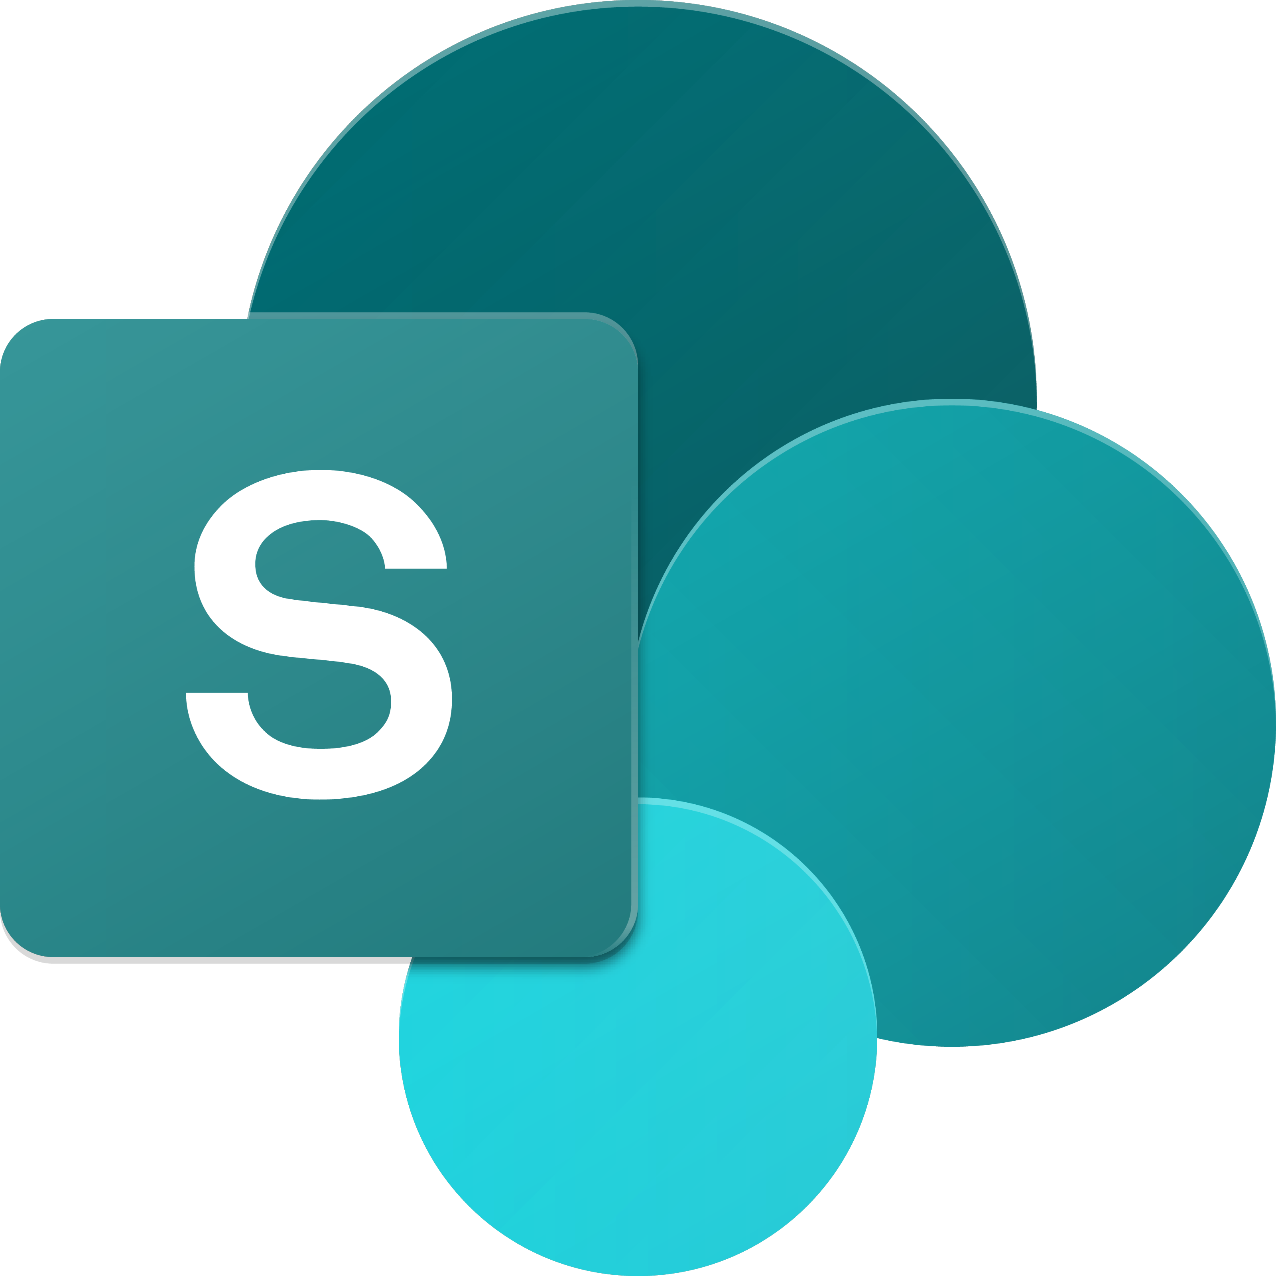
SharePoint UX – Evolving cross versions
SharePoint
Portal Server 2001
SharePoint
Portal Server 2003
Office SharePoint
Server 2007
SharePoint
Server 2010
SharePoint
Server 2013
SharePoint
Server 2016, SPO
2001
2003
2006
2009
2012
2016 …
ASP
Early Server Widget Tech
Single Box
ASP.NET
Web Parts
CAML
SharePoint Publishing
FAST acquisition
Shared Services (e.g. taxonomy)
First Client-Side Rendering Using XSL
Search driven publishing sites
Client-Side Rendering sprinkled in, e.g. CBS, MDS, etc.
Hybrid
Modern standalone cloud apps, e.g. Office 365 Video, Delve, etc.
…
SPFx and Office Fabric
Modern SharePoint pages
Notes:
The SharePoint user experience has been evolving across multiple versions throughout the years.
SharePoint has a long history going back to the first release of SharePoint Portal Server 2001. The figure above displays the versions of SharePoint Microsoft has released over the years. After the initial release, Microsoft rewrote SharePoint on ASP.NET and introduced web parts in with the SharePoint Portal Server 2003 release.
As SharePoint's popularity grew, developers started to take interest in extending the product. Office SharePoint Server 2007 introduced multiple capabilities for developers, namely features, and solutions. Microsoft also merged the Microsoft Content Management Server, web content management solution, into SharePoint as site publishing capabilities.
SharePoint Server 2010 added multiple shared services to the product, including taxonomy, shared search services, and the ability to incorporate external business data into SharePoint sites.
In 2012, Microsoft introduced a new development model enabling developers to externalize customizations to run either in the browser, or on servers other than the servers were SharePoint was installed. This new model, the SharePoint Add-in model, was introduced in SharePoint Server 2013 and was released along with significant investments to the SharePoint REST API. SharePoint Server 2013 also adopted the OAuth 2.0 protocol and introduced the ability for developers to create apps that had their own identities.
More recently, with SharePoint Server 2016, SharePoint Server 2019, and SharePoint Online, Microsoft noticed customers were using client-side development techniques to customize and extend SharePoint. Client-side customizations are the foundation and inspiration for the SharePoint Framework.
Present day SharePoint exists in one of two versions:
- **SharePoint Server 2019**: This is the on-premises version of SharePoint that customers install and maintain on their servers.
- **SharePoint Online**: This is the hosted version of SharePoint, managed by Microsoft as part of Microsoft 365.

Slide 7
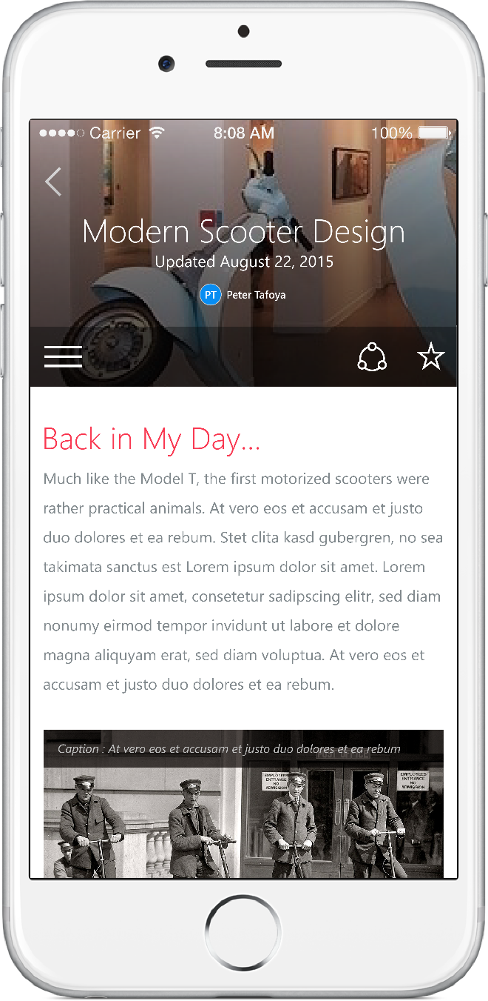
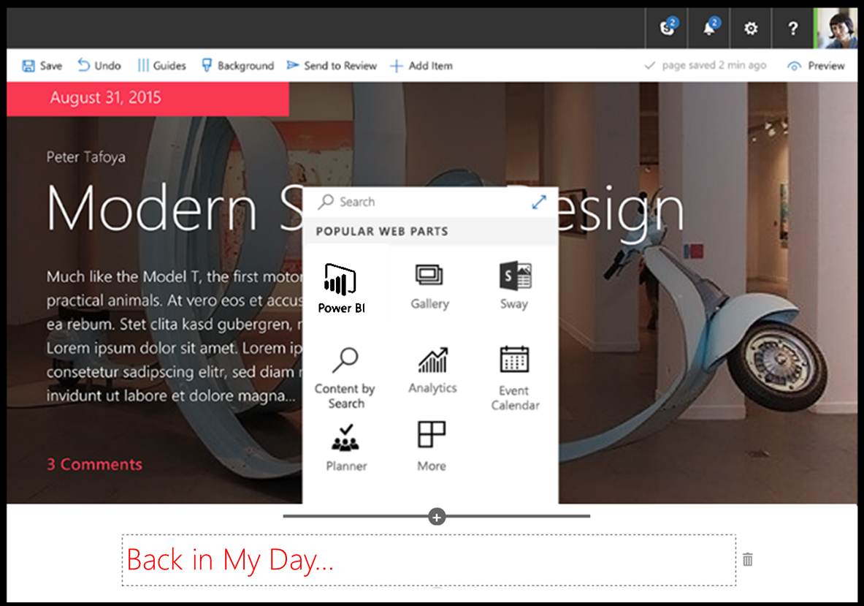
SharePoint Framework
Modern client-side development
Lightweight web and mobile
Powers our own experiences
Backward compatible
Supports open source tools & JavaScript web frameworks
SharePoint Framework
Microsoft Graph
LOB Systems and Cloud Services
Notes:
SharePoint Framework is modern client-side development. All the customizations you create and build are deployed and run in the browser. There is no server-side component in a SharePoint Framework component.
You can create server-side components, but you're going to host that yourself in a location other than SharePoint.
SharePoint Framework components are lightweight and run in both web and mobile experiences because they are client-side solutions. We're relying on JavaScript, HTML, CSS, and images. This means they run the exact same way in the browser as it does in the mobile experiences.
The SharePoint Framework is backwards compatible meaning that it works not just the modern pages, but also on classic and publishing pages as well.
The development tools and platform used in the SharePoint Framework is implemented with open-source tools and common JavaScript web frameworks like React.

Slide 8
Is all SP Online development in JavaScript?
In similar ways as with SharePoint Add-in model, server-side development is needed for back end services
No
SharePoint Framework concentrates on user interface, not on fundamentals around the API usage
You should be considering hosting your business logic and long running tasks in Azure, for example using Azure Functions or custom WebAPIs
Notes:
Is all SharePoint Framework development done in JavaScript?
No, and in many similar ways as the SharePoint Add-in development model, server-side development is needed for backend scenarios.
The SharePoint Framework is simply concentrating on the user interface side of components, not on the fundamentals around the API usage. You can still create server-side solutions, but they're not going to be visible or surfaced in SharePoint Online or run within a SharePoint process.
Instead, you can create a SharePoint Framework component that can interact with those backend APIs.

Slide 9
Office 365 Developer Tenant Setup Steps
Sign up for an Office 365 Developer Tenant
Create new site collection(s) for testing – normal, dev, teams
Create app catalog site
Use online workbench to test your code
1-2-3
Notes:
There are a few things you need to take into consideration when setting up a SharePoint Framework development environment. First you need to set up a Microsoft 365 developer tenant.

Slide 10
Sign up for an Office 365 Developer Tenant
Sign up for the Office Developer Program - https://aka.ms/offdp
You will receive welcome mail with link to sign up for Office 365 tenant
Notes:
A developer tenant is no different than a normal production tenant. Microsoft provides developers, through the Office Developer Program to get access to a developer tenant. The developer tenant same thing you would normally get when you purchase Office 365 licenses.
> [!TIP]
> Sign up for the Office Developer Program at [https://aka.ms/offdp](https://aka.ms/offdp).

Slide 11
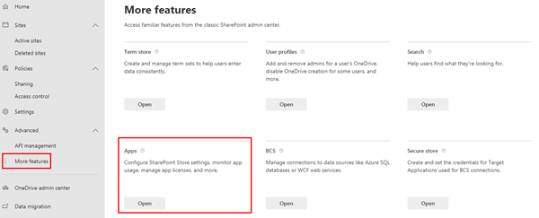
Create App Catalog Site
https://[tenant]-admin.sharepoint.com
SharePoint Framework solutions are deployed to an app catalog when they are ready for distribution
Notes:
Once you have a developer tenant, you need to create an App Catalog site. The App Catalog is where you deploy your custom packages that contain your components that you want to test or share with others in your organization. You can think of it like the SharePoint Store in a sense

Slide 12
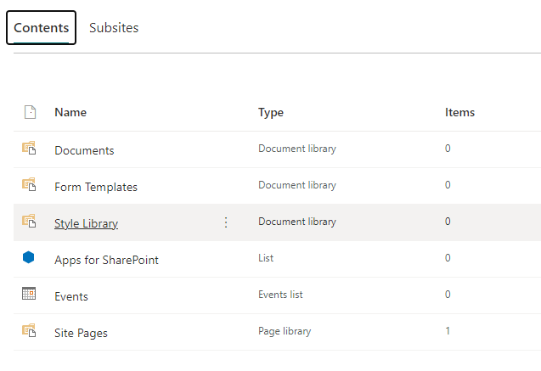
Create Site Level App Catalogs (optional)
Visible in Site Contents
Creation only available through PowerShell
Add-PnPSiteCollectionAppCatalog
Add-SPOSiteCollectionAppCatalog
Notes:
Once you have a developer tenant, you need to create an App Catalog site. The App Catalog is where you deploy your custom packages that contain your components that you want to test or share with others in your organization. You can think of it like the SharePoint Store in a sense

Slide 13
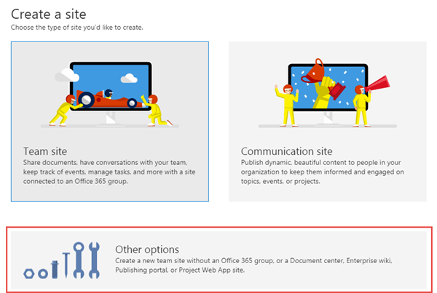
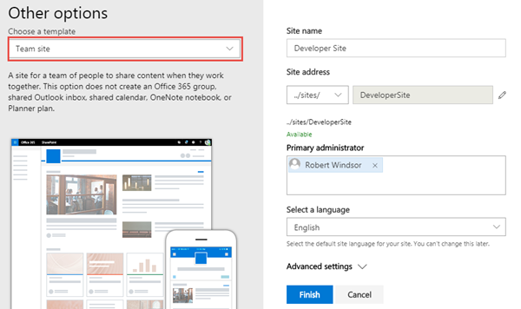
Create a new Development/Testing Site collection
https://[tenant]-admin.sharepoint.com
Use this site collection to test web parts and extensions
Notes:
You then need to create a modern site collection for testing your custom components.

Slide 14
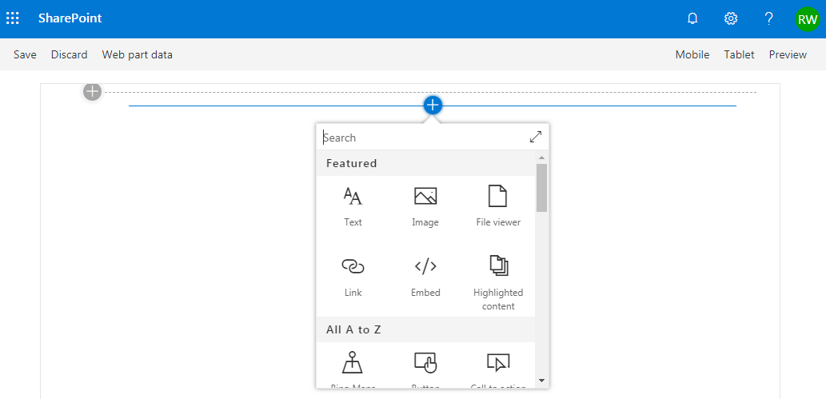
SharePoint Online Hosted Workbench
https://[sharpeointonline-site]/_layouts/workbench.aspx
SharePoint Online workbench can be accessed under any site with _layouts URL. Hosted site provides you site context where solution is executed.
Notes:
All SharePoint modern sites have something called the *workbench*. The workbench is where you can test your components when they're going to be running up in SharePoint Online sites. From the workbench, you can work with live data from the SharePoint REST API.

Slide 15
Demo Configuring Your Office 365 Development Environment

Slide 16
Configuring your SPFx Development Environment
Tool Comparison: Server-side vs. client-side
Node.js
NPM, Yeoman, Gulp
TypeScript
Creating your first SPFx webpart project
Notes:
In this unit, you'll learn what you need to install on your development environment to start creating SharePoint Framework components.

Slide 17

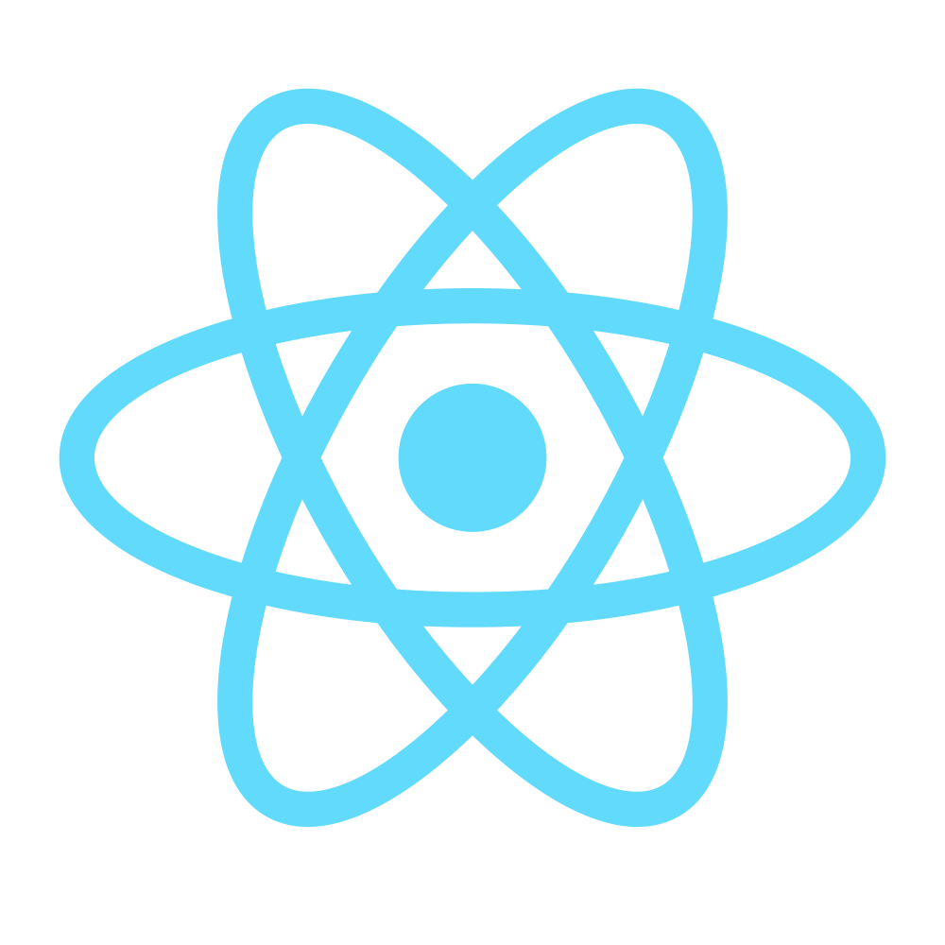

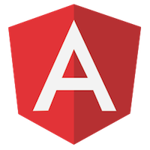


Open source tooling
SharePoint Framework leverages an open source, Node.js based toolchain and embraces all web frameworks + code editors
Build Process & Tooling
Yeoman Templates
Gulp (task runner)
Node.js
NPM (package manager)
SystemJS
Webpack
SASS
TypeScript
Web Frameworks
React
Angular
Knockout
jQuery
… and more… your choice!
Code Editors
Visual Studio Code
Atom
Sublime
Webstorm
… and more… your choice!
Notes:
Microsoft has adopted the open-source tooling for the foundation of SharePoint Framework development. Three categories to explore when it comes to open-source tooling & libraries related to the SharePoint Framework are as follows:
- build process & tooling
- web frameworks
- code editors
Let's look at the build process and tooling first. Yeoman is used to replace the new project experience that traditional server-side SharePoint developers are familiar with in Visual Studio.
Gulp is a task runner that replaces the tool MSBuild used in .NET solutions. This is used to run various tasks, like transpiling TypeScript to JavaScript, creating JavaScript bundles and SharePoint packages.
Node.js is the underlying runtime used by all applications. The tools we're covering in this section are all built on top of Node.js. Node.js is required to run them, just like the .NET Framework is required to run .NET apps.
NPM is used as the package manager and you'll use it to install global tools and reusable code in your projects.
Webpack is used to combine all the JavaScript and CSS files in your project into a single JavaScript bundle. Bundles are the recommended way to deploy client-side applications for performance reasons.
These are tools that are not built and provided by Microsoft, rather they're maintained by the community and are all open-source tools. One benefit of using these tools is that they are cross platform, so the same tools can be used regardless if your development environment is Windows, MacOS, or Linux.
### Web frameworks
When building client-side applications, developers commonly use web frameworks. The SharePoint Framework doesn't limit you to any specific framework. You can use any of the popular web frameworks in your projects including React, Angular, Knockout, or Vue.js. You can even use the popular jQuery library in your custom apps.
### Code editors
You'll also want to get a code editor to develop your project. Most developers are use Visual Studio Code by Microsoft. It's a lightweight version of Visual Studio and is just a text editor that understands TypeScript and can be customized using extensions.
However, you aren't limited to Visual Studio Code. You can choose a different editor if you wanted to. Something as simple as notepad, Atom, Sublime, or WebStorm will work as well. It doesn't matter what you use as all development is done though text editors.

Slide 18
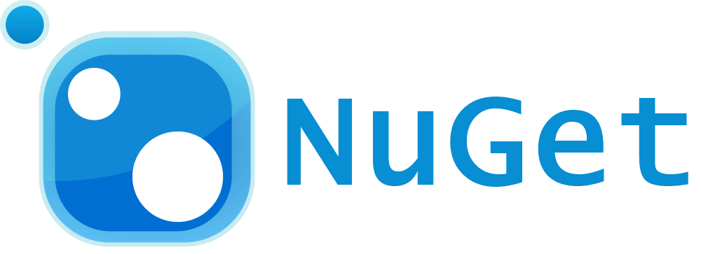

Server-side tool comparison
IIS Express
C#
MSBuild
Project Templates
Notes:
The SharePoint Framework development toolchain is a significant change from the traditional server-side SharePoint development experience. Let's look at the two development toolchains to see how they're compare and contrast
The top row is the server-side tool comparison, starting with the Microsoft IIS web server. This includes the .NET Framework, NuGet used for package management, MSBuild used for running build and packaging tasks, C# as the development language and Visual Studio for the development experience.
The bottom row represents the SharePoint Framework tools. Notice the lines drawn between the tools so you can see how the two compare.
Let's look at each of the tools used in the SharePoint Framework development and build toolchain.

Slide 19
Node.js - Runtime
Cross platform JavaScript runtime
Similar to .NET Framework is a runtime for C# based projects
Used to execute JavaScript on the desktop / server / devices
API wrapper to Chromes V8 JavaScript engine
Also works in Edge
SPFx’s open source tooling is built on Node.js
SPFx supports Node.js LTS v8.* and v10.*
LTS: Long term support
SharePoint Server 2016 only supports v8.*
Node Version Manager (nvm)
Solves problems of multiple version of Node.js on same device
Separate versions for Windows and MacOS/Linux
https://nodejs.org/
Notes:
Node.js is a JavaScript runtime for running JavaScript on devices outside of the browser. Its a wrapper to the V8 JavaScript engine from the Chromium open-source browser project with some extra APIs that allow the V8 engine to run outside of the browser. This enables JavaScript to run on desktops, laptops, servers, and other devices.
> [!NOTE]
> Chromium is the project both of the browsers Google Chrome and Microsoft Edge are based on.
In the context of the SharePoint Framework, Node.js is needed as its the runtime for the development and build tools previously covered. The SharePoint Framework doesn't require you to become a Node.js developer, but you need to install it so the apps in the development and build toolchain will run.
When compared to the server-side toolchain, Node.js serves the same role as the .NET Framework.

Slide 20
NPM – Node Package Manager
NPM is a package manager for Node.js based projects
Similar to NuGet that is the .NET Framework package manager
Client tool used to acquire packages from the NPM registry: https://www.npmjs.com
Similar to NuGet that’s the client tool for the NuGet registry: https://www.nuget.org
Included with the default Node.js install
Alternate package managers
Why? SPFx HelloWorld: 48 files, 520KB → 65K files, 500MB
Yarn
Pnpm
https://www.npmjs.com
Notes:
NPM is a package manager for Node.js-based projects and is included with the Node.js installation. Its one of many package managers that can download and install packages from the npmjs.org registry.
When compared to the server-side toolchain, NPM serves the same role as NuGet.

Slide 21
Yeoman – Project Scaffolding Generator
Scaffolding engine that executes generators
Generators prompt user with questions
Generates project scaffolding (folders & files) for projects
Microsoft provides SharePoint Framework generator
Installed on your dev environment with NPM
npm install -g yo
npm install -g @microsoft/generator-sharepoint
http://yeoman.io
Notes:
When building server-side SharePoint components using the Add-in model or as features or solutions, developers used Visual Studio to create and develop the project. The first step in these models is to create a project using the *New Project* wizard experience. This wizard collects information about the project and then scaffolds the project by creating folders, files, and customizing the files based on the responses to the questions.
Visual Studio Code doesn't have this *New Project* wizard experience. To simplify project creation, Yeoman is used to create the project.
Yeoman is a scaffolding engine that runs generators. A generator defines the set of questions and understands how to scaffold a new project or modify existing projects.
Microsoft provides a generator to scaffold SharePoint Framework projects, both new projects and to add components to existing projects.

Slide 22
Gulp – Task Runner
Gulp is a task runner for projects
Similar to MSBuild that is the .NET Framework task runner
Tasks are defined with JavaScript
Similar to MSBuild tasks defined in XML
Performs common tasks: compile, package, start test process, etc.
Microsoft has created all required tasks
npm install -g gulp
http://gulpjs.com
Notes:
Gulp is the task runner we use to do different tasks in our development and build process. Gulp executes tasks that are written in JavaScript. You'll use gulp to do things like building your project and transpiling the SAAS files to CSS and TypeScript to JavaScript. You'll use other tasks to combine the resulting files into bundles & package the resulting files into a SharePoint package file used for deployment.
When compared to the server-side toolchain, Gulp serves the same role as MSBuild.

Slide 23
TypeScript – Typed JavaScript
Typed superset of JavaScript
Compiles to plain JavaScript
Development language for the base templates in SharePoint Framework projects
You can also integrate native JavaScript to SharePoint Framework customizations *
No need to rewrite everything
Version of TypeScript supported by SPFx included in each SPFx project
https://www.typescriptlang.org
Notes:
TypeScript is the language that you're going to write your SharePoint Framework projects with. Its super set of JavaScript with extra capabilities it to make JavaScript development easier to manage.
If you aren't familiar with JavaScript or you're not familiar with TypeScript, think of it as like a C# flavor to JavaScript. TypeScript's most popular features are type checking, the ability to use classes, and future features coming to JavaScript but not yet implemented or available except in preview.
Similar to C# based projects, you don't deploy TypeScript to production. Rather its used to create intermediate files. The output of TypeScript is JavaScript, similar to how the output of C# is intermediate language (IL).
When compared to the server-side toolchain, TypeScript serves the same role as C#.

Slide 24
Validate local SPFx development configuration
Install required runtimes & tools:
Node.js & NPM (included with Node.js)
Yeoman, SPFx Yeoman generator
Gulp
Create first project with Yeoman & SPFx generator
Build & run web part in the local workbench
yo @microsoft/sharepoint
gulp serve

Slide 25
Demo Configuring Your Local Developer Environment

Slide 26
Exploring a SharePoint Framework Project
Solution Lifecycle
Anatomy of a SharePoint Framework Project
Test/Debug the project
Deploy solution
Notes:
In this unit, you'll learn about the different components in a SharePoint Framework project, and get an overview of the build and deployment process.

Slide 27
Client-side Web Part Build Flow
npm install @Microsoft/generator-sharepoint -g
gulp serve
gulp bundle --ship
Install SharePoint Generator
Test
Package/Deploy
yo @microsoft/sharepoint
workbench
gulp package-solution --ship
Scaffold SharePoint Web Part Project
Local or Hosted
Package/Deploy
Code .
manual upload of the app
Build Web Part Code
UAT / Pre-production
Release using app catalog*
Ship?
Available on Classic and Modern Pages
Notes:
Now that you understand the important folders and files in a project, let's look at the build toolchain and flow for a SharePoint Framework project. This scenario will focus on a project that contains a web part component. Other types of components, such as extensions and libraries, may involve a slightly different process or step.
In the figure above, the first column covers configuring your development environment for SharePoint Framework development by installing all the necessary dependencies. You then create the project using the Yeoman generator for the SharePoint Framework and develop your component.
Moving onto the second column, test your component in the local or hosted workbench by executing the command `gulp serve` from the command line from the root folder of the project. This task will build, bundle, start the local web server, launch the default browser, and navigate to the local workbench. Here you can add your web part to the local workbench's page to test it.
You can also test it in the hosted workbench by using the same browser and navigating to the hosted workbench. The hosted workbench will load the component from your local web server in the browser.
Follow standard development practices by iterating the component until you settle with the final version of your component that is ready to deploy.
The third column represents the deployment process. You'll first re-bundle the component using the `gulp bundle --ship` command that recreates the bundle for production. Next, create the deployable SharePoint package using the `gulp package-solution --ship` command. This command generates the **\*.sppkg** file.
Finally, Upload the SharePoint package to your tenant's or site collection's App Catalog site. At this point, the app can be installed in a site collection that will add the web part to the web part toolbox where it can be added to a page in edit mode.

Slide 28
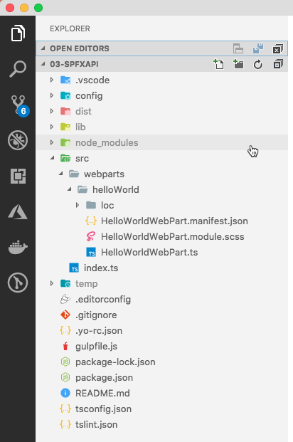
Project Structure
.vscode: includes Visual Studio Code integration files
config: includes all config files
dist: created automatically on builds – contains out from bundle process
lib: created automatically on builds – contains pre-bundled built files
node_modules: created automatically when installing all package dependencies with a package manager
src: this is the main folder of the project, it includes the web part, styles, and a test file
temp: created automatically on builds - contains local dev webserver files
Notes:
The Yeoman generator for the SharePoint Framework creates the scaffolding (*folders & files*) for a new SharePoint Framework project. After building the project the first time, you'll see even more folders and files present. Just like a .NET Framework project, some of the generated files are temporary and should not be kept in source control.
Let's look at the folders in a newly created and built SharePoint Framework project:
**.vscode**: This folder contains contains Visual Studio Code specific files.
**config**: This folder contains configuration files used by the project's various build tasks. You'll edit these files as necessary depending on the types of components you're creating and for specific situations, such as the site to test extensions or adding references to external libraries.
**dist**: This folder, created automatically when you bundle the project, contains the JavaScript bundle & manifest created by the build process that will be used in deployment.
**lib**: This folder, created automatically when you build the project, contains the temporary files generated from the compilation and transpilation of TypeScript to JavaScript and SCSS to CSS files.
**node_modules**: This folder is created automatically when installing package dependencies using the `npm install` command.
**src**: This folder contains all the source code for your project.
**temp**: This folder, created automatically when you test the project, contains files used by the local development web server.
> [!NOTE]
> The **dist**, **lib**, **node_modules**, and **temp** folders should not be committed to your source control solution because they are automatically generated by the build process and when installing or restoring dependencies.
>
> These folders are similar to the **bin**, **obj**, and **packages** folder generated in a .NET project.

Slide 29
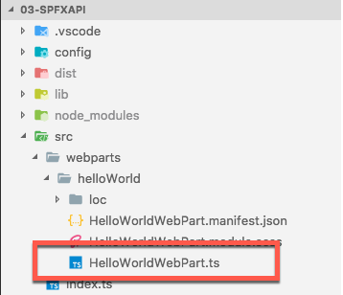
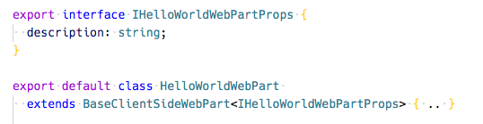
Key Files – web part class
Defines the main entry point for the web part
Extends the BaseClientSideWebPart
All client-side web parts must extend the BaseClientSideWebPart class in order to be defined as a valid web part
Interface that defines the non-standard public properties on the web part
Persisted when the web part is saved / published from edit mode
Notes:
When you are creating web parts, the Yeoman generator for the SharePoint Framework will create a web part class file and add it to your project. This file is located within in the **./src/webparts/\[webpartName\]** folder. The name of the web part is added to the folder and the class' file name.
This file defines the main entry point for the web part and extend the `BaseClientSideWebPart` class. All client-side web parts must extend from this base class.
The web part file will contain both the web part class and in interface. The interface defines the nonstandard public properties on the web part and are persisted when the web part is saved or published from edit mode.

Slide 30
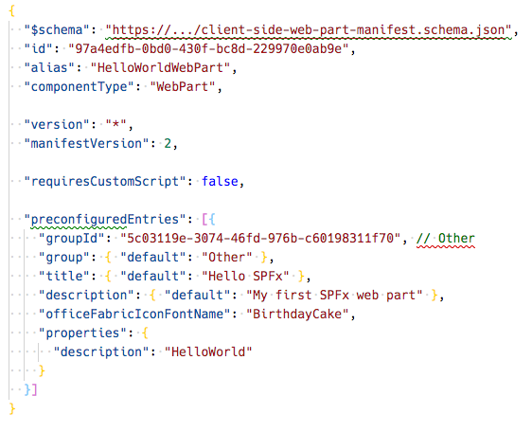
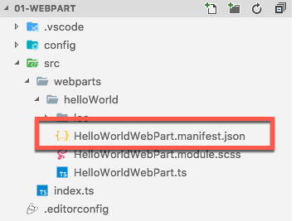
Key Files – web part manifest
Defines the web part metadata
Notes:
The web part manifest file, **\*.manifest.json**, is located in the same folder as the web part class. It contains metadata for the web part that include things such as the web part's ID, alias, the type of component, and its version.
Web parts will also contain a section for `preconfiguredEntries` that are the default values for the public properties set on the web part when it is added to a new page.

Slide 31
CSS Modules
https://github.com/css-modules/css-modules
All CSS classes are locally scoped
.helloWorld {} => .helloWorld_da83fer {}
SPFx’s build toolchain handles the complexities
Rules
*.module.scss - HelloWorldWebPart.module.scss
Use camelCasing; not kebab-casing
Reference classes in components as styles.helloWorldButton
Notes:
CSS modules address a challenge you may have when working with client-side solutions. CSS classes can be used to not only set the styles of an element on the page, but can also override other CSS classes. If a CSS class name is present on the page more than once, the last one will override any settings on previously defined classes. For example, having different web parts that use the same CSS class name on the same page can impact the rendering of each web part.
CSS modules address this challenge by creating a globally unique name for each CSS class. A class named `.helloWorld` is translated to `.helloWorld_da83fer` for example. The hash at the end of the class name is unique to that web part project.
The SharePoint Framework build toolchain handles the complexities of generating these class names and referencing them in the your web part.
You define your classes in a SASS file. The class names can use **camelCasing** but not **kebab-casing** for the CSS module process to work. The SharePoint Framework build pipeline generates JavaScript and TypeScript type definitions for all the classes that map to the generated class names. In your web part, you will import the style object, `import styles from './HelloWorldWebPart.module.scss';`, and then reference the styles as a real TypeScript object:

Slide 32
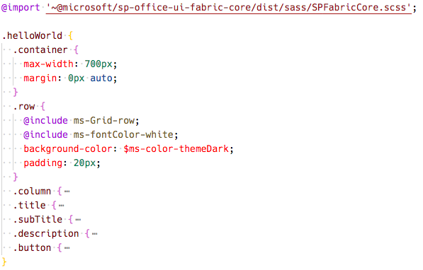
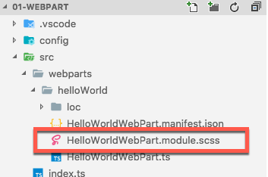
Key Files – SCSS file
Defines the web part styles
Notes:
When the project is built & compiled, the SharePoint Framework build process will do two things with this file.
First, it will compile the SCSS => CSS for use in the browser.
Then, it will generate two additional files.
One is a JavaScript file that exports a single object with the name/value properties will have the CSS module local unique names as the values for the class names that are the properties. The other file is a TypeScript declaration file that contains an interface of this file. Using these two files you can import them into your web part and reference the friendly class names rather than the generated CSS local module names.

Slide 33
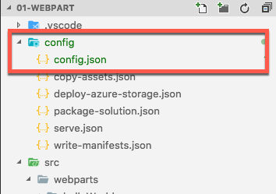
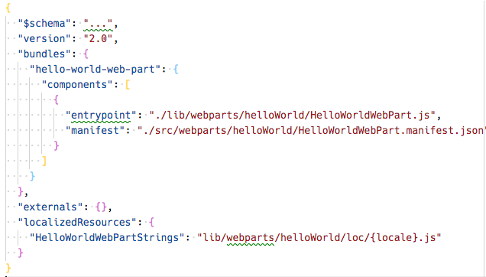
Key Files – config file
Contains information about your bundle(s), any external dependencies, localized resources
Specifies the AMD script libraries used in the web part
Notes:
The **./config/config.json** file contains information about your JavaScript bundles, external dependencies, and localized resources.
The `bundles` node enables developers to control the name of the bundle file created by the bundling process and what components are included in the bundle. Each component is listed by the primary JavaScript file that contains the component and the component's manifest. These values are used by the SharePoint Framework's bundling process when it configures webpack on each build.
> [!NOTE]
> Webpack, another open-source tool, is included in each project's dependencies and is entirely managed by the build process. There is nothing for the developer to install or configure.
The `externals` node is where you can define external libraries that you don't want to be included in the resulting bundle created by Webpack. For example, if our component used the popular library jQuery, you shouldn't include it as part of the bundle. Instead, the external library should be loaded from an external CDN prior to loading the component bundle on the page. In this case, you'd add the jQuery CDN reference to the `externals` node. During the bundling process, when Webpack sees a reference to jQuery, it will ignore it and not include it in the bundle. In addition, the component's manifest will be modified to instruct the module loader in at runtime to load jQuery prior to loading the component's bundle.

Slide 34
What the Gulp tasks do
clean: deletes temp folders created by build process (ie: dist, lib, temp)
build: build the project
default: equivalent to bundle
bundle: build, localize, and bundle the project
dev-deploy: deploy the current project to a development Azure CDN for sharing builds with colleagues
deploy-azure-storage: upload the assets to a Azure storage container
package-solution: package the project into a SPPKG
test: build, localize, and bundle the project and run tests, and verify the coverage
serve: build and bundle the project and run the development server
trust-dev-cert & untrust-dev-cert: trusts / untrusts the development SSL certificate in the local machine’s trusted root authority (self-hosted HTTPS site)
Notes:
The SharePoint Framework development and build toolchain includes numerous tasks developers will need to run in order to build, package, deploy, and configure their projects and environments. These tasks are executed using the popular open-source tool **Gulp**. Microsoft has created and included multiple tasks in every project to perform the following tasks:
- **clean**: This task deletes deletes the **dist**, **lib**, and **temp** folders created from building and bundling the project.
- **build**: This task will transpile all TypeScript to JavaScript and all SASS to CSS files. These temporary files are built to the **lib** folder.
- **bundle**: This ask will run the **build** task and then create JavaScript bundle(s) with Webpack using the files from the build task.
- **dev-deploy** & **deploy-azure-storage**: These tasks upload the production manifest and JavaScript bundles to the Azure storage blob specified in the **./config/deploy-azure-storage.json** configuration file when you've elected to use the Azure CDN to host and serve your files.
- **package-solution**: This task will create a **\*.sppkg** SharePoint package file using the output from the **bundle** task.
- **serve**: The serve task will start the local web server that hosts the local workbench.
- **test**: This task will run the **build** task and then run all unit tests defined in the project.
- **trust-dev-cert** & **untrust-dev-cert**: These two tasks are used to trust and untrust the self-signed development SSL certificate on your local development environment. The local web server started up by the **serve** task uses this self-signed certificate. The SSL certificate must be added to your development environment's trust root authority for the browser to accept the request.

Slide 35
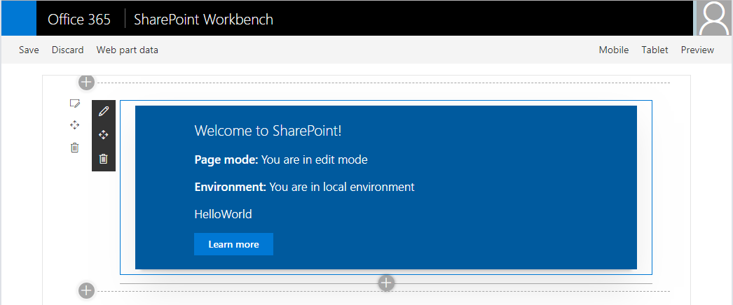
SharePoint Workbench
Local development time experience
Test your changes immediately even in offline mode
Notes:
Microsoft provides developers two options to test SharePoint Framework projects. The *workbench* is a special SharePoint page that contains a single canvas that developers can add their web parts to. There are two different workbench options: local & hosted.

Slide 36
Local Workbench vs. SharePoint Workbench
Local
Runs on https://localhost
Has no SharePoint Context
Developers can leverage uses mock data
SharePoint (Hosted)
Runs on a real SharePoint Site
https://<your-sharepoint-site>/_layouts/workbench.aspx
Has SharePoint Context
Uses SharePoint data
Notes:
### Local workbench
The local workbench is served up by executing the gulp **serve** task. It runs on https://localhost that has no SharePoint context. Its simply an HTML page that loads the SharePoint Framework in the browser.
The local workbench is a great option for developers to develop and test web parts that don't require an instance of SharePoint. For web parts that need SharePoint context or work with live SharePoint data, you will need to mock data requests to test your web part in the local workbench.
### SharePoint-hosted workbench
The SharePoint-hosted workbench is hosted by a real SharePoint site, located at https://{your-sharepoint-site}/_layouts/workbench.aspx. The hosted workbench is unlike the local workbench in that because it is hosted by a real SharePoint site, it has SharePoint context. This means that your web part can access data in SharePoint lists and libraries in the same site as the hosted workbench.
The gulp **serve** task will continue to monitor your project and rebuild it when changes are made. However, unlike the local workbench, it won't automatically refresh the browser containing the hosted workbench. To see the changes, you will need to manually refresh the browser where you loaded the hosted workbench.

Slide 37
Debugging
Build and run on local server and automatically launch local SharePoint Workbench
Build and run solution on local server
> gulp serve
> gulp serve --nobrowser
Notes:
The gulp **serve** task used to start the local web server monitors your SharePoint Framework project's codebase while you are testing web parts in the local workbench. When a file is changed and saved, the gulp task will rebuild the project and reload the local workbench in the browser, offering immediate feedback of you changes.
While hosted in a real SharePoint site, the SharePoint-hosted workbench is still intended to be a local development test environment that allows you to test your code changes immediately.
Both the local and hosted workbenches require you to start the local web server that will serve each workbench the SharePoint component's manifest and JavaScript bundle. To do this, execute the following command at the command line from the root of your project:
```shell
gulp serve
```
This command will run the **build** and **bundle** tasks, start the local web server, launch the default browser, and load the workbench page. If you don't want it to launch the browser automatically, include the `--nobrowser` switch:
```shell
gulp serve --nobrowser
```

Slide 38

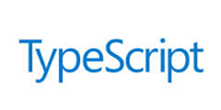
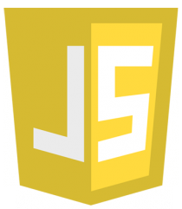
Mapping Files Making Debugging Easier
SPFx web parts are authored in TypeScript
The build process transpiles the TypeScript into JavaScript, then bundles it all into a single file
As a result, it can be hard to debug the resulting JavaScript bundle
Source code mapping files make it possible to debug the original unbundled TypeScript code
Notes:
SharePoint Framework projects is authored with TypeScript and the build process transpiles the TypeScript into JavaScript. It then bundles the built files into a single file. As a result of this transpiling & bundling process, it can be hard to debug the JavaScript that's generated in the build process and map it back to the TypeScript you wrote.
Source code mapping files make it possible to debug the original TypeScript code from the running JavaScript code. Mapping files map each line in the generated JavaScript code back to the TypeScript code it was generated from. When you set a breakpoint in JavaScript, a tool such browser development tools or editors like Visual Studio Code, will show you the TypeScript when your breakpoint is hit, even though it's the JavaScript that's running.

Slide 39
Demo Creating and running your first SPFx webpart solution

Slide 40
Deploying the solution
Objects & Files involved in Deployment
Build, Bundle & Ship
Deploying SharePoint Assets
Deployment Steps
Notes:
In this unit, you'll learn how to package and deploy SharePoint Framework solutions to production.

Slide 41
Client-side Web Part Build Flow
npm install @Microsoft/generator-sharepoint -g
gulp serve
gulp bundle --ship
Install SharePoint Generator
Test
Package/Deploy
yo @microsoft/sharepoint
workbench
gulp package-solution --ship
Scaffold SharePoint Web Part Project
Local or Hosted
Package/Deploy
Code .
manual upload of the app
Build Web Part Code
UAT / Pre-production
Release using app catalog*
Ship?
Available on Classic and Modern Pages
Notes:
Now that you understand the important folders and files in a project, let's look at the build toolchain and flow for a SharePoint Framework project. This scenario will focus on a project that contains a web part component. Other types of components, such as extensions and libraries, may involve a slightly different process or step.
In the figure above, the first column covers configuring your development environment for SharePoint Framework development by installing all the necessary dependencies. You then create the project using the Yeoman generator for the SharePoint Framework and develop your component.
Moving onto the second column, test your component in the local or hosted workbench by executing the command `gulp serve` from the command line from the root folder of the project. This task will build, bundle, start the local web server, launch the default browser, and navigate to the local workbench. Here you can add your web part to the local workbench's page to test it.
You can also test it in the hosted workbench by using the same browser and navigating to the hosted workbench. The hosted workbench will load the component from your local web server in the browser.
Follow standard development practices by iterating the component until you settle with the final version of your component that is ready to deploy.
The third column represents the deployment process. You'll first re-bundle the component using the `gulp bundle --ship` command that recreates the bundle for production. Next, create the deployable SharePoint package using the `gulp package-solution --ship` command. This command generates the **\*.sppkg** file.
Finally, Upload the SharePoint package to your tenant's or site collection's App Catalog site. At this point, the app can be installed in a site collection that will add the web part to the web part toolbox where it can be added to a page in edit mode.

Slide 42
SharePoint Framework Deployment Artifacts
Installation & registration files
Included in SharePoint package deployed to SharePoint app catalogs
Makes SharePoint aware of components
Includes:
App manifest
Feature framework files
etc.
Component runtime files & dependencies
Optionally included in SharePoint package or deployed to another location (CDN)
/config/package-solution.json ➔ includeClientSideAssets
Referenced by SharePoint when components are loaded on pages
Includes:
JavaScript bundles
Images
CSS
etc.
Notes:
Let's start by looking at the SharePoint Framework deployment artifacts to understand the different things required for SharePoint Framework solutions to work in production.
There are two different kinds of files:
- **Installation and registration**: The installation and registration files are included in SharePoint packages deployed to the SharePoint App Catalogs. These files make SharePoint aware of the components included in the packages.
These files include an app manifest file, feature framework files, and other files that SharePoint needs to provision the components. It doesn't include files that make the application run.
- **Component runtime files and dependencies**: These are the files that are needed to run the SharePoint Framework component once it's been deployed and installed in a SharePoint environment. Any dependencies your component uses, such as third-party web framework libraries, can optionally be included in the component's bundle or loaded at runtime from an external CDN. The component's manifest file defines all dependencies the component requires to be present on the page prior to it loading and running.
These files include JavaScript bundles of your components, images, CSS files, and JavaScript libraries or assets your component depends on.

Slide 43
Build, Bundle & Package Solution
Build
gulp build
Transpiles TypeScript to JavaScript
Generates TypeScript type declarations
Transpiles SCSS to CSS
Bundle
gulp bundle [--ship | -p]
Generates JavaScript bundle(s)
Generates component manifest(s)
Files added to /dist folder
Package Solution
gulp package-solution [--ship | -p]
Generates all files needed for deployment to SharePoint
Generates all files needed to run components
Creates *.sppkg file
Files added to /temp & /sharepoint folder
Files added to /lib folder
Notes:
SharePoint Framework projects are deployed to production using *packages*. A package filename ends with the **sppkg** extension. There are three steps to creating the package.
### Build
The build phase transpiles all TypeScript to Javascript, generates TypeScript type declarations from you TypeScript files, and transpiles SCSS files to CSS. All these files are placed in the **lib** folder in your project.
The build process is initiated when you run the gulp task **build** from the command line:
```shell
gulp build
```
### Bundle
The next phase is bundling. The bundling phase generates a JavaScript bundle and the manifest for the SharePoint Framework component.
Bundling takes all the JavaScript and CSS files referenced in your project and combines them into a single JavaScript bundle. A configuration file enables developers to specify if multiple bundles are generated with specific components in them, or if all components in the project are grouped into a single bundle.
The popular open source tool Webpack is used to create the JavaScript bundle file. Normally developers need to create a configuration file and pass it into webpack when bundling, but the SharePoint Framework does this for you. When the bundling task is executed, the SharePoint Framework build toolchain dynamically creates the webpack configuration using configuration files in the project.
The files generated in the bundling phase are saved to the **dist** folder in the project.
The bundling process is initiated when you run the gulp task **bundle** from the command line. When you add the optional `--ship` or `-p` to the command, the bundling process will also minify the resulting bundle and manifest file. Minification removes all code comments and white space in the file to create the smallest possible file that's downloaded when the component is loaded on the page.
```shell
gulp bundle
```
### Package solution
The last phase is packaging. The packaging phase generates all the files necessary to deploy your SharePoint Framework solution to SharePoint. These files are combined in to a ZIP archive with the file name **\*.sppkg** that's saved to the **sharepoint** folder in your project. This file is referred to as the *SharePoint package*.
Prior to packaging all the files into the SharePoint package, the package solution phase generates multiple files necessary for deployment. This includes creating the app manifest, any feature definitions and element manifests necessary for provisioning the components, and collecting all the runtime files such as the bundle, component manifest and string localization files.
Depending on the project configuration, the component runtime files including the bundle, component manifest, localization files, are placed in the **./temp/deploy** folder or added to the package. You can configure this setting using **./config/package-solution.json** file using the `includeClientSideAssets` property. When set to `true`, the files are added to the package and are automatically provisioned to the SharePoint library **ClientSideAssets** in the root of the site collection where the app is installed. Otherwise, when the property is set to `false`, you are responsible for deploying the files to a location your users can access, such as an Azure CDN.
The packaging process is initiated when you run the gulp task **package-solution** from the command line. When you add the optional `--ship` or `-p` to the command, the packaging process will also modify manifest files for production, setting the URL where the component's runtime files can be located. This location is defined in the **./config/write-manifests.json** file.
```shell
gulp package-solution
```

Slide 44
Different Build / Packaging Modes: Debug & Production
Debug
All generated files are left un-minified
JavaScript source map files included in transpilation process
Built files assumed to be loaded from local webserver (https://localhost:4321)
Production
All files minified
No JavaScript source map files generated
Built files assumed to be loaded from ultimate production locations (CDN)
Notes:
In the previous section, you learned that two of the gulp tasks used in creating a SharePoint package support an optional `--ship` switch. This switch indicates you are bundling and packaging for production. When the switch isn't present, it indicates you are bundling and packaging for development or debugging.
The gulp **build** task doesn't have any switches, but both the **bundle** and **package-solution** tasks support the optional `--ship` switch. When running **bundle** and **package-solution**, make sure both either use or don't use the `--ship` switch. In other worse, don't use it on one and not the other.
### Debug mode
When bundling and packaging the solution in debug mode, all generated files are left un-minified. This means the code comments and white space is left in the generated bundle and component manifest files.
The bundling process also generates JavaScript source map files that can be used when debugging the component at runtime. Source map files map the generated JavaScript to the source TypeScript code so when a breakpoint is hit in JavaScript, you'll be able to easily debug the TypeScript and not have to figure out what TypeScript code mapped to the generated JavaScript code.
The debug mode assumes that all files are served from the local web server. Even if you deploy and install the SharePoint package in a SharePoint environment, SharePoint will look for the component's bundle and manifest file on the local web server.
## Production mode
When bundling and packaging the solution in production mode, all generated files are minified. This means the code comments and white space is removed in the generated bundle and component manifest files to create the smallest files that will be downloaded at runtime in the browser.
Unlike the debug mode, the production mode does not generate source map files.
> [!TIP]
> Developers can configure the webpack configuration using the SharePoint Framework build toolchain API to generate source map files when bundling in production mode.
The production mode assumes that all files are served from their production locations. This is defined in the **./config/write-manifests.json** configuration file.

Slide 45
Deploying SharePoint Assets
SharePoint package (*.sppkg) always deployed to SharePoint App Catalog
Tenant-scoped App Catalog
Site Collection-scoped App Catalog
Component executable files deployed to hosting location
Must be accessible to all users of the site
Multiple manual options:
Office 365 CDN
Azure CDN
Public / internal URL
Leverage the includeClientAssets in the project’s package-solution.json file
Includes executable files in the *.sppkg
Automatically deployed to Office 365 tenant’s CDN’s
Notes:
After creating the SharePoint package, the next step is to deploy it to a SharePoint environment. There are two ways to deploy SharePoint packages. Both options are SharePoint App Catalogs.
SharePoint Online supports two types of App Catalogs: tenant-scoped and site collection-scoped.
The other part of package deployment addresses the runtime files required for your component to function. This includes your component's JavaScript bundle and manifest files as well as any external dependencies. These files must be deployed to a hosting location that all the users on a site can access.
### Deploying component runtime files
The decision on where to host these runtime files falls into two categories. The first category are manual options. With this option, you manually copy or upload files to the target location. Some examples of the manual deployment option include the Office 365 CDN, an Azure CDN, or any location that is on a public or internal URL. The only requirement is that the files must be accessible to the users of your site.
The other option to deploy the runtime files is more automatic. In late 2017, Microsoft introduced a setting `includeClientAssets` to the **./src/config/package-solution.json** file. When this property is set to true, the runtime files are included in the SharePoint package.
When you install an app from the SharePoint package in a site collection, SharePoint will copy the runtime files to a hidden library, **ClientSideAssets**, in the root of the site collection. Your component's manifest file contains a special URL that is replaced at runtime by the SharePoint Framework to point to the site collection's **ClientSideAssets** library.
If you've enabled the Office 365 CDN, this library is included in the list of libraries that are backed by the CDN.

Slide 46
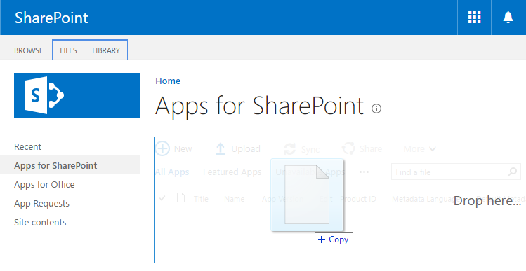
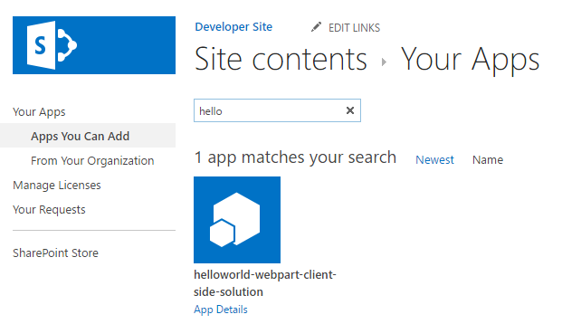
Deployment & Installation Steps
Build the project
gulp build
Generate the bundle & manifests
gulp bundle --ship
Generate the SharePoint package
gulp package-solution –ship
Upload the package (*.sppkg) to the app catalog
Install the app from the site collection’s Site Contents page
Notes:
Let's review the deployment and installation steps for a SharePoint Framework solution.
Build the project: The first step is to build your project with the **gulp build** command. This will create all the files that are used in the deployment of your solution.
Generate the bundle and manifest: Next, create the component bundle and manifest files for production using the **gulp bundle --ship** command. This step takes the files from the build step and creates the files that will be deployed to SharePoint.
Generate the SharePoint package: The final step in the packaging process is to create the SharePoint package with the **gulp package-solution --ship** command. This step takes the results from the bundle phase, generates the necessary deployment files including an app manifest and associated feature files, and packages them into a single archive named **\*.sppkg**.
Upload the package to the App Catalog: Now that you've created the package, the next step is to upload the package to one of the SharePoint App Catalogs. Part of this process is to also trust the package, indicating to SharePoint the app within the SharePoint package are safe to run in your environment. This step makes the components available for installation and use within your SharePoint environment.
Install the app from the site collection's Site Contents page: The last step is to install the app from the package into a site collection. This is done from the **New > App** menu in the **Site Contents** library in a site collection.

Slide 47
Demo Build, Bundle, Package, Deploy & Install a SharePoint Framework Solution

Slide 48
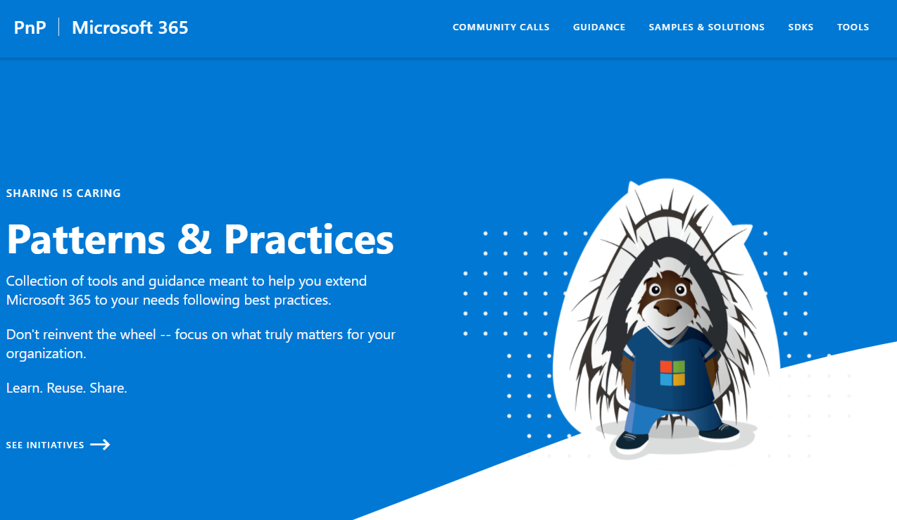
Microsoft Patterns & Practices (PnP)
aka.ms/m365pnp
Notes:
After creating the SharePoint package, the next step is to deploy it to a SharePoint environment. There are two ways to deploy SharePoint packages. Both options are SharePoint App Catalogs.
SharePoint Online supports two types of App Catalogs: tenant-scoped and site collection-scoped.
The other part of package deployment addresses the runtime files required for your component to function. This includes your component's JavaScript bundle and manifest files as well as any external dependencies. These files must be deployed to a hosting location that all the users on a site can access.
### Deploying component runtime files
The decision on where to host these runtime files falls into two categories. The first category are manual options. With this option, you manually copy or upload files to the target location. Some examples of the manual deployment option include the Office 365 CDN, an Azure CDN, or any location that is on a public or internal URL. The only requirement is that the files must be accessible to the users of your site.
The other option to deploy the runtime files is more automatic. In late 2017, Microsoft introduced a setting `includeClientAssets` to the **./src/config/package-solution.json** file. When this property is set to true, the runtime files are included in the SharePoint package.
When you install an app from the SharePoint package in a site collection, SharePoint will copy the runtime files to a hidden library, **ClientSideAssets**, in the root of the site collection. Your component's manifest file contains a special URL that is replaced at runtime by the SharePoint Framework to point to the site collection's **ClientSideAssets** library.
If you've enabled the Office 365 CDN, this library is included in the list of libraries that are backed by the CDN.

Slide 49
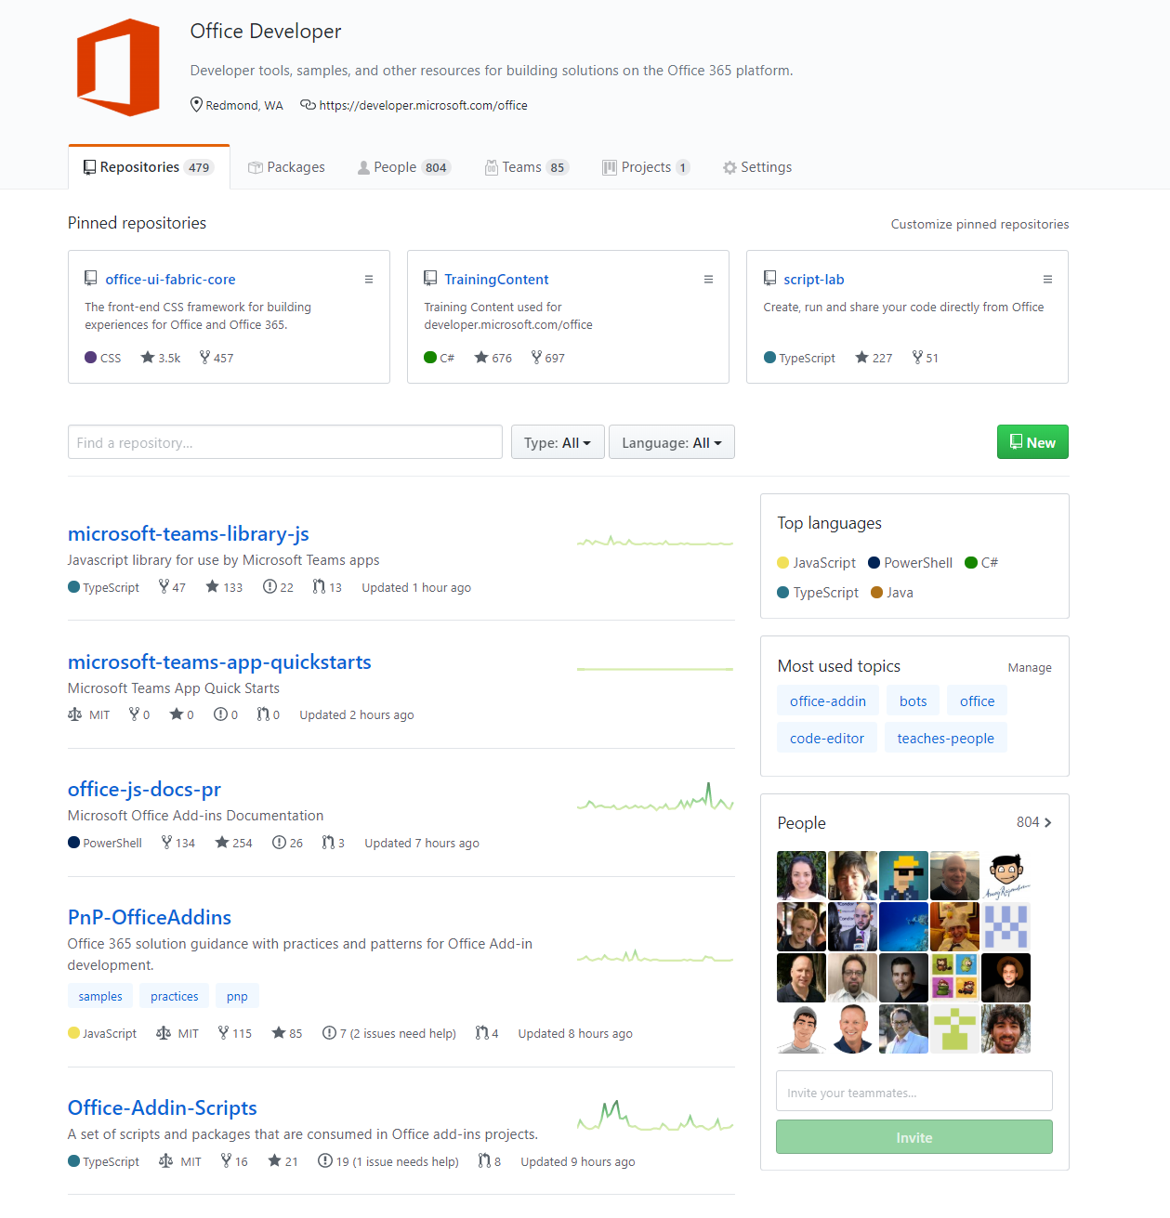
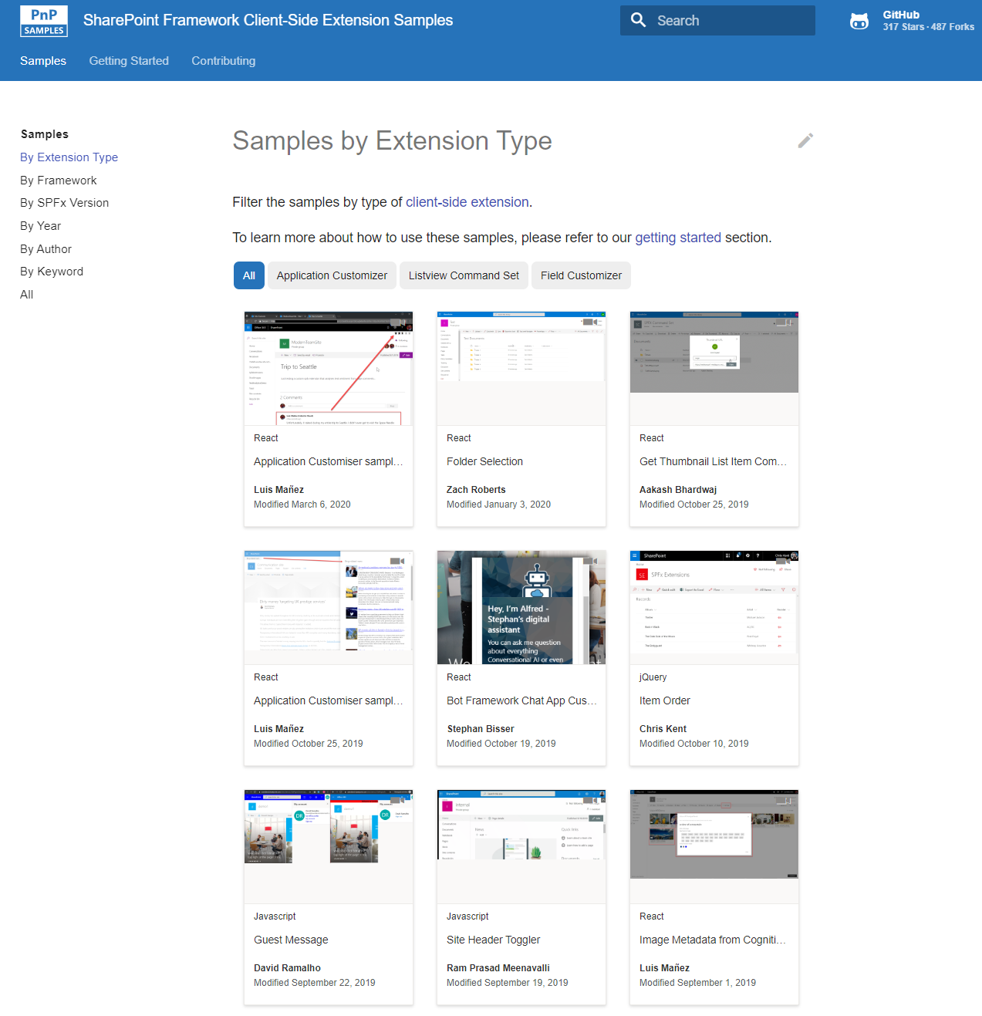
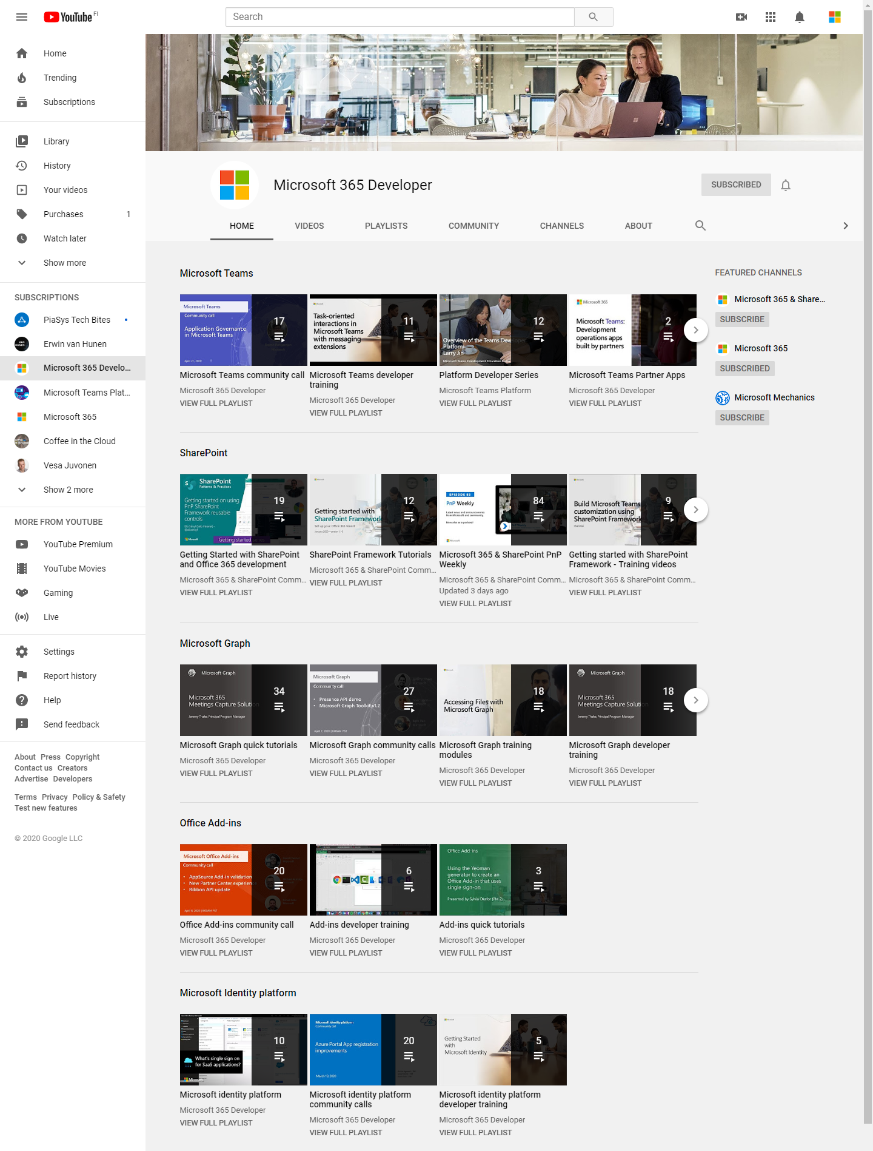
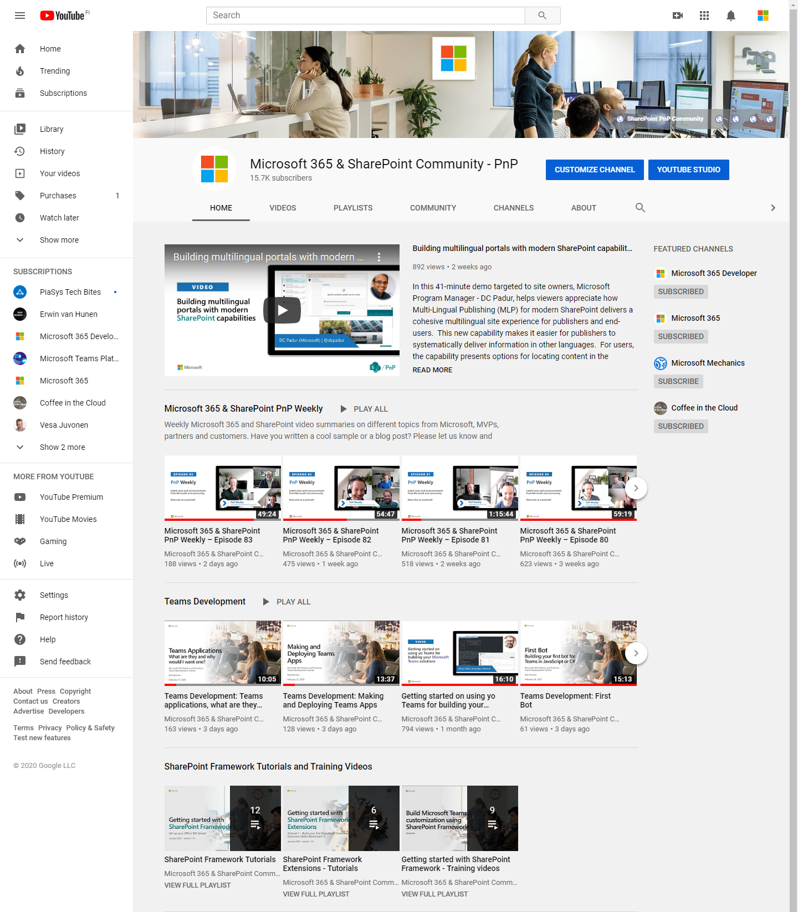
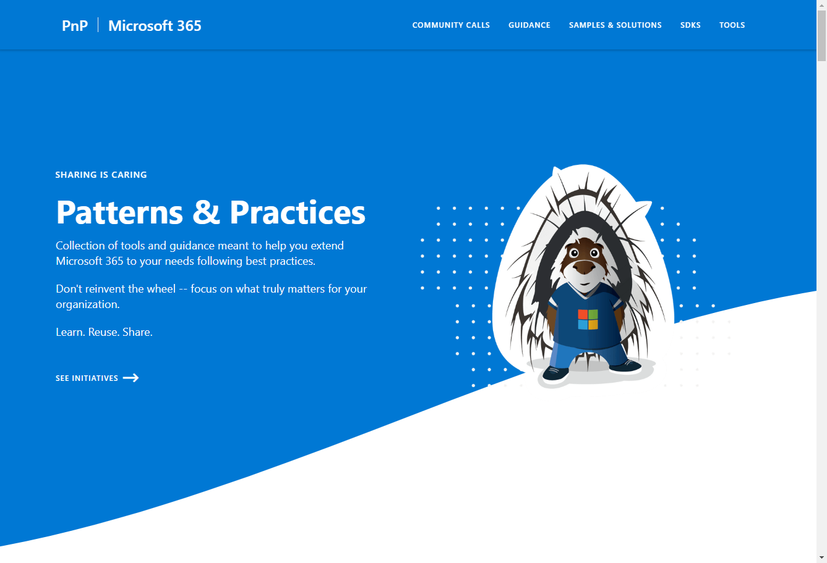
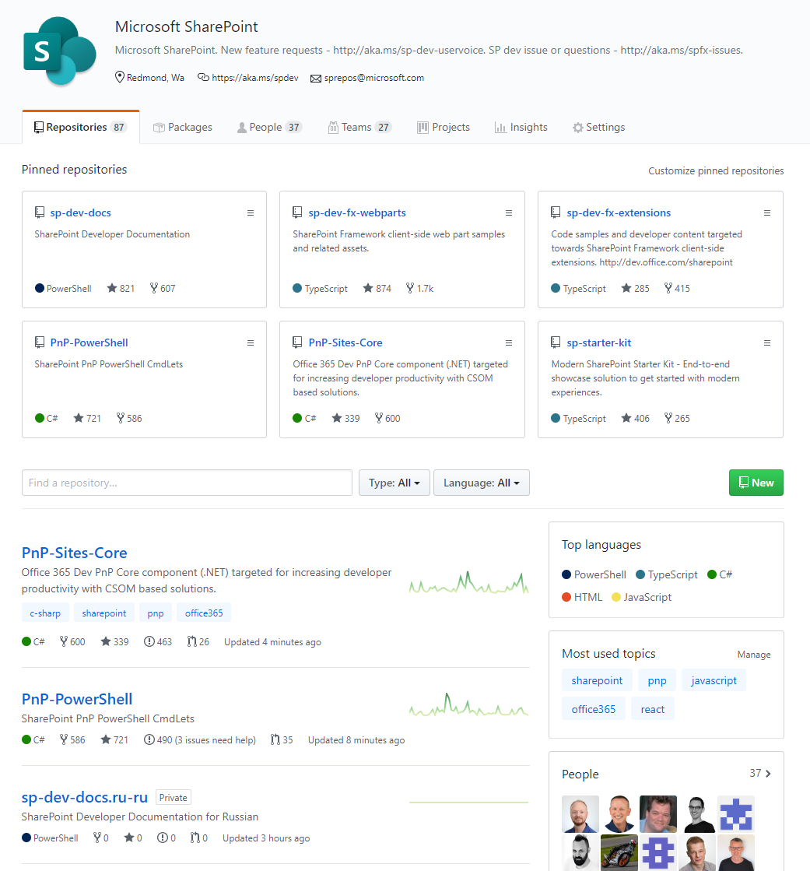
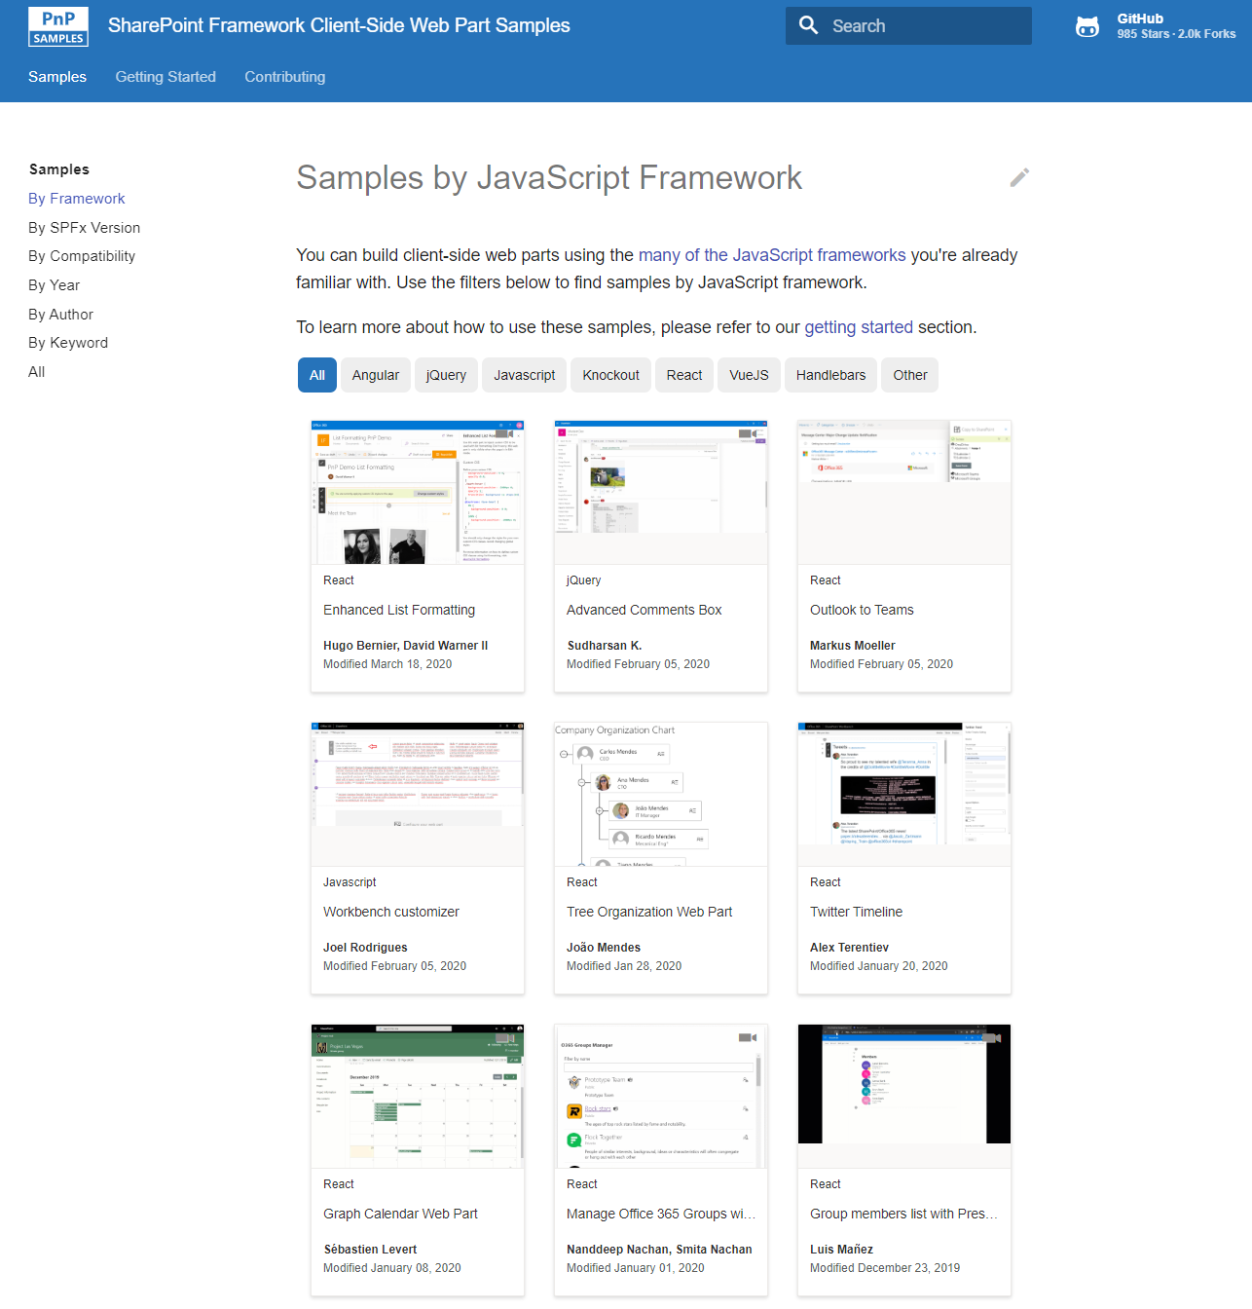
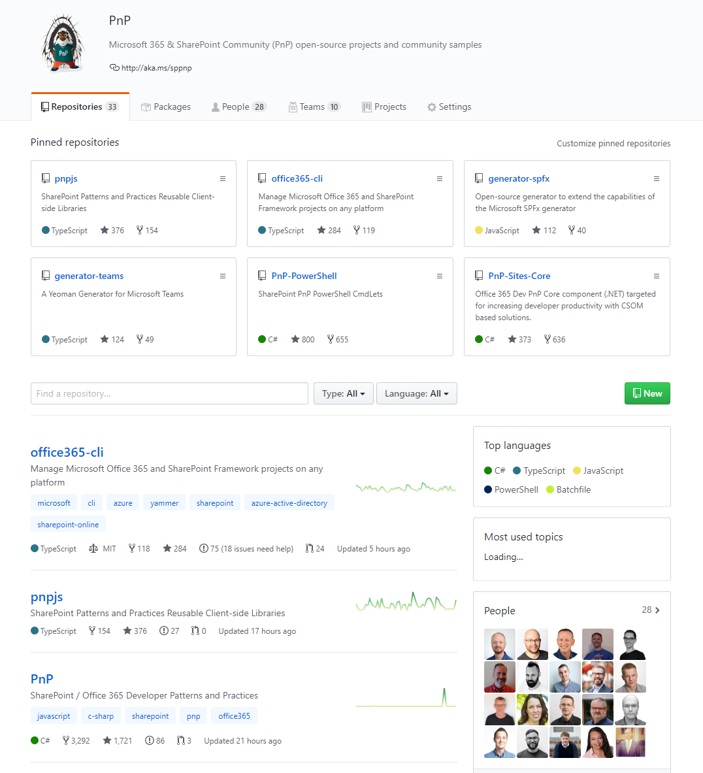
Microsoft 365 developer videos
Microsoft 365 & SharePoint community
(PnP) videos
Open-source
Sample galleries
Open source initiatives and samples
aka.ms/m365devyoutube
aka.ms/m365pnp-videos
github.com/sharepoint
github.com/pnp
github.com/officedev
github/microsoftgraph
aka.ms/spfx-webparts
aka.ms/spfx-extensions
aka.ms/list-formatting
aka.ms/teams-samples
aka.ms/m365pnp
SharePoint Framework documentation – https://aka.ms/spfx
@Microsoft365Dev | @m365pnp

Slide 50
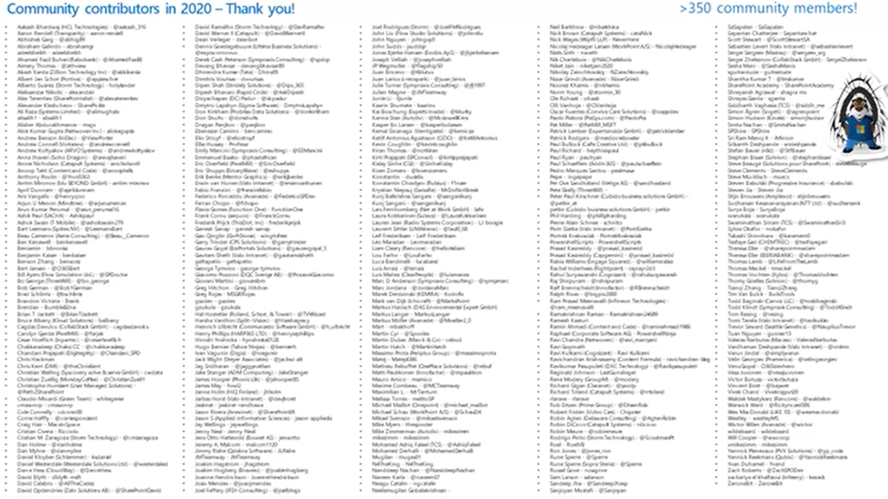

Slide 51
Other developer sessions at NACS (https://www.collabsummit.org/sessions/)
Tues@8:30, Don Kirkham, INTRODUCING THE SHAREPOINT FRAMEWORK
Tues@11:00, Cindy Bennight, CREATE YOUR FIRST SPFX REACT WEB PART
Tues@1:30 (Online), Rob Windsor, BUILDING YOUR FIRST APPS WITH THE MICROSOFT GRAPH
Tues@1:30, Eric Shupps, DEVELOPING SHAREPOINT FRAMEWORK SOLUTIONS FOR THE ENTERPRISE
Tues@2:50, Alex Terentiev, DEVELOPING REACT TEMPLATES USING SHAREPOINT FRAMEWORK LIBRARY COMPONENTS
Wed@8:30, Eric Shupps, A BEGINNERS GUIDE TO CREATING CUSTOM CONNECTORS FOR POWER APPS AND POWER AUTOMATE
Wed@9:45, Don Kirkham, AUGMENTING MICROSOFT 365 DEVELOPMENT USING VISUAL STUDIO CODESPACES
Wed@11:00, Alex Terentiev, SHAREPOINT FRAMEWORK CONNECTED WEB PARTS
Notes:
Let's review the deployment and installation steps for a SharePoint Framework solution.
Build the project: The first step is to build your project with the **gulp build** command. This will create all the files that are used in the deployment of your solution.
Generate the bundle and manifest: Next, create the component bundle and manifest files for production using the **gulp bundle --ship** command. This step takes the files from the build step and creates the files that will be deployed to SharePoint.
Generate the SharePoint package: The final step in the packaging process is to create the SharePoint package with the **gulp package-solution --ship** command. This step takes the results from the bundle phase, generates the necessary deployment files including an app manifest and associated feature files, and packages them into a single archive named **\*.sppkg**.
Upload the package to the App Catalog: Now that you've created the package, the next step is to upload the package to one of the SharePoint App Catalogs. Part of this process is to also trust the package, indicating to SharePoint the app within the SharePoint package are safe to run in your environment. This step makes the components available for installation and use within your SharePoint environment.
Install the app from the site collection's Site Contents page: The last step is to install the app from the package into a site collection. This is done from the **New > App** menu in the **Site Contents** library in a site collection.

Slide 52

References
MS Learn: Extend Microsoft SharePoint – Associate
https://docs.microsoft.com/en-us/learn/paths/m365-sharepoint-associate/
Mastering the SharePoint Framework
https://www.voitanos.io/
Microsoft Patterns and Practices
https://aka.ms/m365pnp
Notes:
Let's review the deployment and installation steps for a SharePoint Framework solution.
Build the project: The first step is to build your project with the **gulp build** command. This will create all the files that are used in the deployment of your solution.
Generate the bundle and manifest: Next, create the component bundle and manifest files for production using the **gulp bundle --ship** command. This step takes the files from the build step and creates the files that will be deployed to SharePoint.
Generate the SharePoint package: The final step in the packaging process is to create the SharePoint package with the **gulp package-solution --ship** command. This step takes the results from the bundle phase, generates the necessary deployment files including an app manifest and associated feature files, and packages them into a single archive named **\*.sppkg**.
Upload the package to the App Catalog: Now that you've created the package, the next step is to upload the package to one of the SharePoint App Catalogs. Part of this process is to also trust the package, indicating to SharePoint the app within the SharePoint package are safe to run in your environment. This step makes the components available for installation and use within your SharePoint environment.
Install the app from the site collection's Site Contents page: The last step is to install the app from the package into a site collection. This is done from the **New > App** menu in the **Site Contents** library in a site collection.

Slide 53
Lab 1
Exercise 1 - Setting up the Office 365 Tenant
Exercise 2 - Configuring the Local Dev Environment
Exercise 3 - Creating & Running Your First SPFx Project
Exercise 4 – Deploying Your Solution

